Slide 1

Customer Segmentation
Prepared by:
Reem Thamer AL-Rashidi :

Slide 2
Overview
Introduction
Dataset
Data Cleaning
Visualization
Data Model
Conclusion

Slide 3
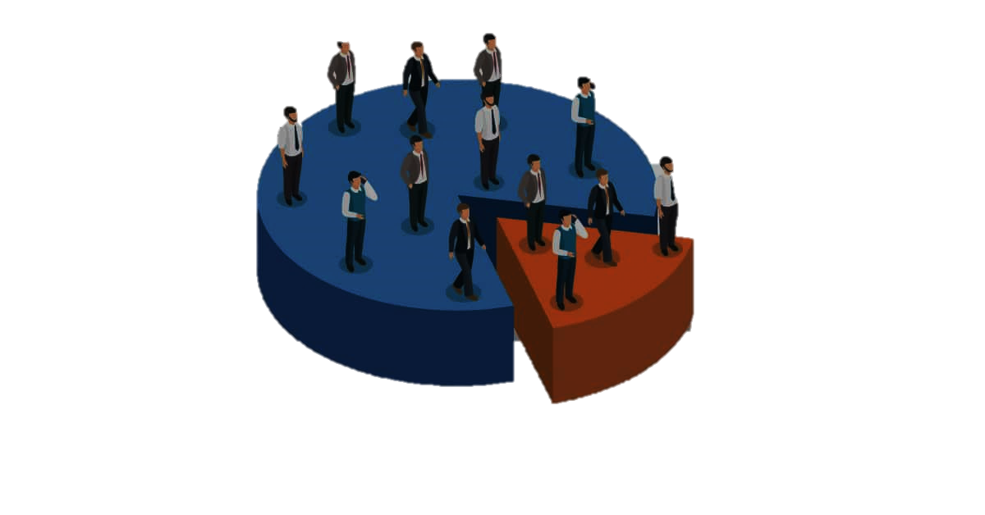
Introduction
Market segmentation refers to the process of dividing the consumer market for existing and/or potential customers into groups (or segments) based on common traits, interests, and behaviors. The basic concept is that consumers who share common traits are more likely to respond to marketing communications in a similar manner so that companies can reach each group in a more relevant and effective manner.

Slide 4
Customer Segmentation Classification Dataset
Provided by Kaggle
11 Features
425.37 kB

Slide 5
Data Cleaning
Y
Filling the missing
value
Drop the unnecessary
features
Remove duplicate
row

Slide 6
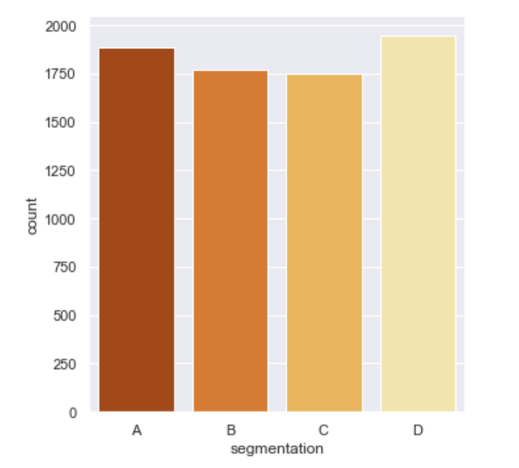
Visualization
An automobile company has plans to enter new markets with their existing products (P1, P2, P3, P4, and P5),
SO, The sales team divided all customers into four groups in the dataset (A, B, C, D). to conduct segmented outreach and communication for a certain customer segment

Slide 7
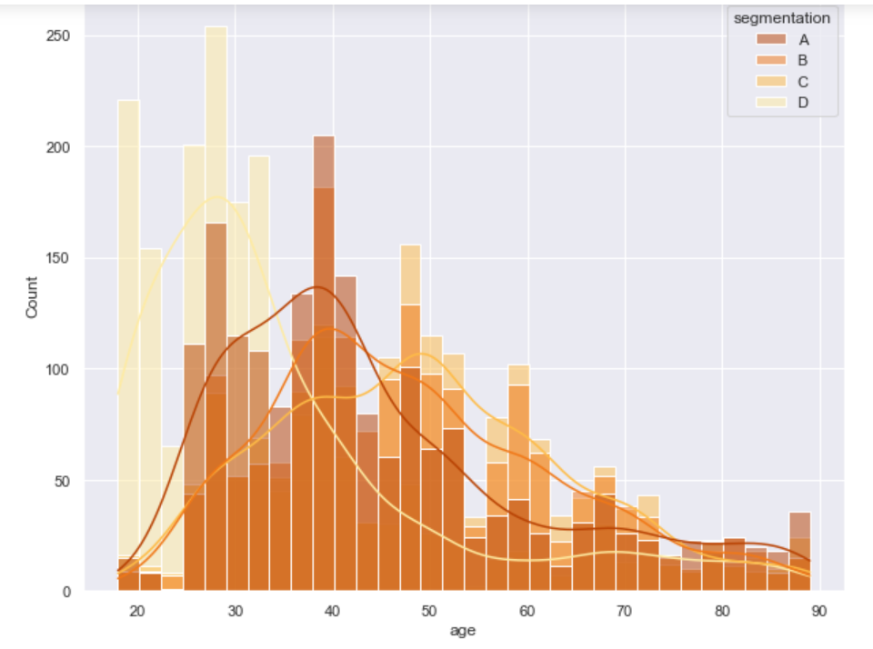
This chart shows there is a difference in age in our segmentation

Slide 8
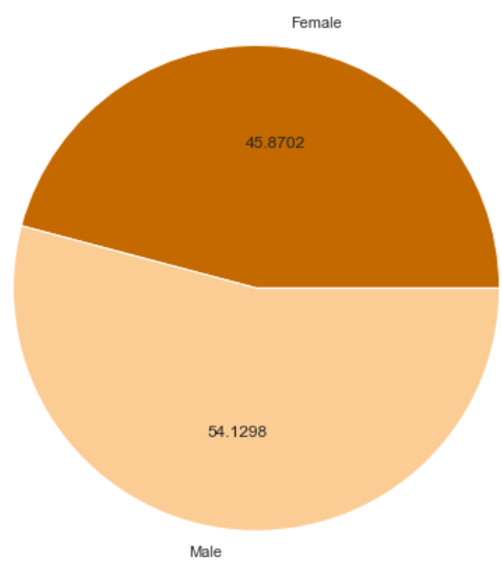
What gender of the customer is active in the market?

Slide 9
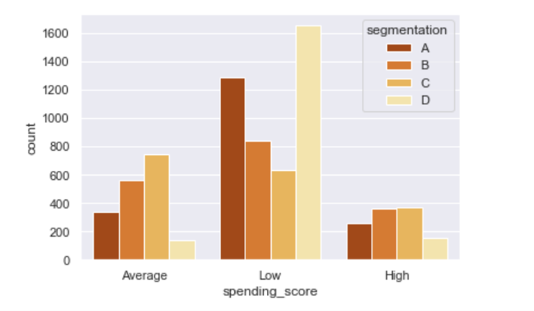
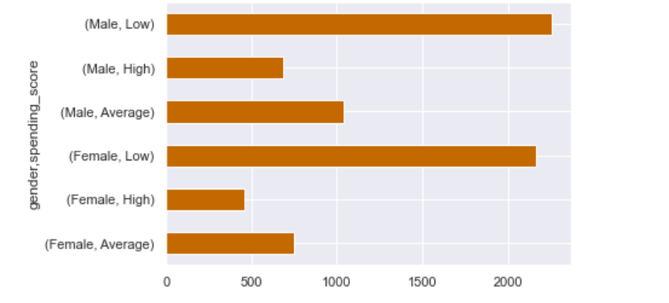
How many spending ranges of the customers?

Slide 10
Data Model
LogisticRegression RandomForest KNeighbors DecisionTree

Slide 11
 | LogisticRegression | RandomForest | KNeighbors | DecisionTree
Accuracy | 46.80% | 42.54% | 41.86% | 45.90%
Recall | 46.80% | 42.54% | 41.86% | 45.90%
Precision | 46.80% | 42.54% | 41.86% | 45.90%
F1-Score | 46.80% | 43% | 41.86% | 45.90%
MODELS

Slide 12
Conclusion
In conclusion, the classifications were used to pick the right group of new clients with whom to conduct awareness and communication.

Slide 13
Tools
NumPy
seaborn
Matplotlib
Pandas

Slide 14
THANKS
Any questions?

